Slide 1
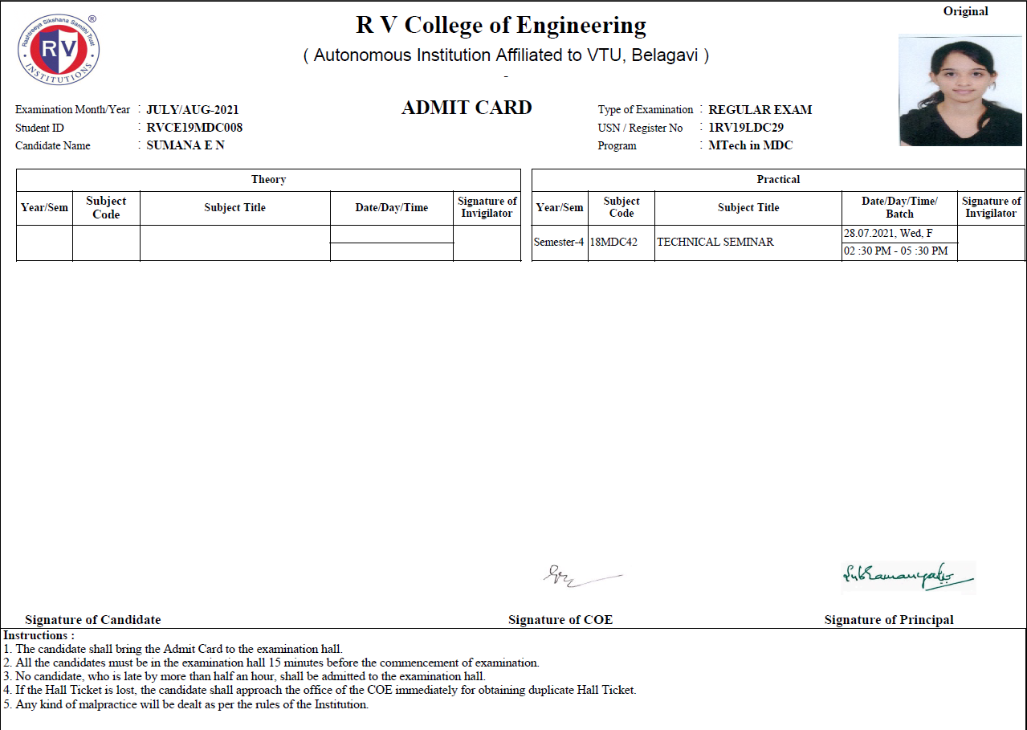


Slide 2

Go, change the world
RV College of
Engineering
Department of Electronics and Telecommunication Engineering
Design of Vehicle to Vehicle Communication System using Visible Light Communication
Major Project : 18MDC33 Phase 2
Sumana E N (1RV19LDC29)
Program : DCE
Guide Name: Viswavardhan Reddy K
Designation: Assistant Professor
Department: ETE
Department of Electronics and Telecommunication Engineering

Slide 3

Go, change the world
RV College of
Engineering
Agenda
Introduction
Literature Survey
Motivation
Problem Definition
Objectives
Key outcomes
Basic idea of project Methodology
CNN and Cascade algorithms and outputs
YOLO Algorithm and outputs.
Challenges faced while recognition
Hardware Implementation
Observations
Calculation of Throughput and Delay
Conclusion
Future Scope

Slide 4
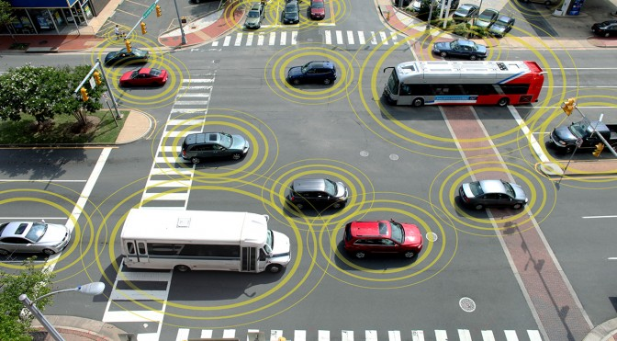
Go, change the world
RV College of
Engineering
Vehicle to Vehicle Communication
Vehicle-to-vehicle (V2V) communications comprises a wireless network where automobiles send messages to each other with information about what they’re doing.
This helps in avoiding crashes/accidents, easing road congestions and also improving environmental standards.
The V2V communications target Automotive Industries, Smart Cities etc.
Fig.1 Real Time Scenario 1

Slide 5
Go, change the world
RV College of
Engineering
Vehicle to Vehicle Communication
Vehicle-to-vehicle (V2V) communications comprises a wireless network where automobiles send messages to each other with information about what they’re doing.
This helps in avoiding crashes/accidents, easing road congestions and also improving environmental standards.
The V2V communications target Automotive Industries, Smart Cities etc.

Slide 6
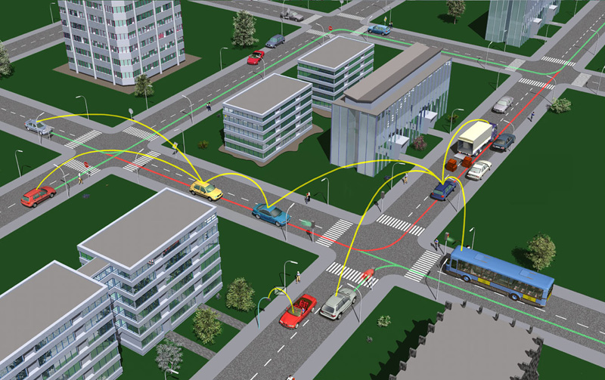
Go, change the world
RV College of
Engineering
Vehicle to Vehicle Communication
Vehicle-to-vehicle communication technology uses dedicated short-range communications (DSRC).
It is ‘Wi-Fi like’ technology as one of the frequency it uses is 5.9 GHz.
The range is up to 300 meters or 1000 feet or about 10 seconds at highway speeds.
The V2V uses DSRC standards i.e., IEEE 802.11p and cellular V2X standards i.e., 3GPP standards as LTE.
Fig.2 Possible Communication Paths

Slide 7
Go, change the world
RV College of
Engineering
Visible Light Communication- LiFi Technology
LiFi is a wireless optical networking technology that uses LEDs for data transmission. In simpler terms, LiFi is considered to be as a light-based Wi-Fi which uses light instead of radio waves to transmit information.
The usage of Light Fidelity (LiFi) technology is most promising for V2V communication.
The LiFi is basically a category of Visible Light Communication (VLC) which involves the use of Visible Light Spectrum (VLS).
The VLS ranges from 380nm-740nm.
The use of LiFi as VLC in V2V communication is promising and is faster as well as eco-friendly.
The LiFi ranges up to 10m which can be termed as Short-Range Wireless Communication (SRWC) and can be extended using mirroring technique.

Slide 8
Go, change the world
RV College of
Engineering
Literature Survey
Sl. No. | Paper Title | Year | Abstract
1. | Proposed Framework for V2V Communication using Li-Fi Technology | 2017 | The work done in this paper deals with the V2V communications as an Intelligent Transport System (ITS). The necessity for the V2V communication as a fully automated process helps in decreasing the accidents on the road. Many topics like Scope, Vision, Communication models like- DSRC, IEEE802.11p etc are discussed. The basic idea as to how to develop a V2V communication system can be obtained from this research.
2. | Visible Light Communication Module: An Open Source Extension to the ns3 Network Simulator With Real System Validation | 2017 | The basic idea implementation of a V2V communication model can be obtained in this research. A frame work using LiFi as well as photodetector for transmission and reception and their working can be understood and a prototype of the blocks for a VLC transmitter and a receiver are studied in this research. The Use of NS3 network simulator brings in a new light and scope for the implementation of the system.
3. | Vehicle To Vehicle “V2V” Communication: Scope, Importance, Challenges, Research Directions and Future. | 2020 | An idea of co-existence of VLC with RF technology is discussed in this research. The need of optimizing the physical medium and research for the higher layers of the network architecture is the motivation in this research. An NS3 simulated network architecture is studied in detail and its implementation in indoor environment is studied.
4. | Environment-Detection-and-Mapping Algorithm for Autonomous Driving in Rural or Off-Road Environment | 2020 | The research mainly deals with the detection and mapping algorithm od obstacles for the autonomous driving system in rural as well as off-road environment. A vehicular system configuration for sensing and detecting the on-road obstacles using LIDAR is used in this paper. The algorithm used is lane detection algorithm and the vehicle is designed to detect pedestrians, crossings and speed bumps on the road
5. | Simulation Modelling of Visible Light Communication Channel for Automotive Applications | 2012 | A simulation model for V2V communication using VLC for a real-time scenario is proposed in this research. The usage of the tail lights as well as headlights of a vehicle as the source for transmission and reception of data is discussed. The simulation of V2V as well as V2I communication for crossroad and metropolitan scenarios is made and the channel characteristics is compared.

Slide 9
Go, change the world
RV College of
Engineering
Sl. No. | Paper Title | Year | Abstract
6 | Visible Light Communication for V2V Intelligent Transport System | 2016 | A cellular network based on software defined networks (SDN) for V2V is researched in the paper. A scheme for data-offloading using vehicular ad-hoc networks (VANET) is implemented using SDN and Mobile Edge Computing (MEC). The link establishment between then vehicles is monitored through a cellular network. The procedure: 1) uses each vehicle’s information; 2) calculates and notifies the users in the network using centralized management strategy; and 3) establishes a VANET routing path for paired vehicles that are currently communicating with each other using a cellular network. The performance analysis is also made.
7. | Visible light communication for V2V intelligent transport system. | 2016 | The usage of off the shelf LED as well as Photodiode for transmitter and receiver is discussed in this research. The use of VLC as a cost-effective method for an integrated Intelligent transport system is the key area of interest. The use of already present lights and the reception of this leads to a low complexity and high reliable communication system between vehicles
8. | VLC link with LEDs used as both transmitters and photo-detectors | 2015 | A development of a 10 Mbps VLC link that uses LEDs as both transmitters and receivers. The system uses binary OOK modulation without any equalization. Transmission distances exceeding 20 cm were obtained with a low power LED and no lenses. The throughput and transmission range are expected to much improve when using high power LEDs and more effective modulation formats.
9. | IEEE 802.15.7 Visible Light Communication: Modulation schemes and dimming support. | 2016 | Research focuses on how to use VLC modulation schemes and probable ways of avoiding the interference from the surrounding ambience. Provided by recent advances in LED technology, IEEE 802.15.7 standard supports high-data-rate VLC up to 96 Mb/s. this is done using fast modulation of optical light sources which are dimmed during their operation. IEEE 802.15.7 standard provides dimming adaptable mechanisms for flicker-free high-data-rate for VLC.
10. | Deep Learning for Optical Vehicular Communication | 2020 | An architecture for the V2V communication using Optical Camera Communication (OOC) is proposed in this research. Hybrid Spatial Phase Shift keying (HSPSK) is used as a standard modulation scheme for OOC. The AI based communication system is discussed. The is analysed to evaluate the performance of the proposed system over a complex channel model in a vehicular environment. The use of AI based decoder makes the approach a novel one.

Slide 10
Go, change the world
RV College of
Engineering
Sl. No. | Paper Title | Year | Abstract
11 | Detection Algorithm for Overlapping LEDs in Vehicular Visible Light Communication System | 2019 | A method to separate the overlapping LEDs is proposed. The edges of the overlapping LED are detected using Canny edge detection algorithm. These edges are extracted based on contour mapping. Then the performance analysis is done for different scenarios.
12 | Vehicle-to-Vehicle Communication Technology | 2019 | Obstacle recognition based on depth images is widely studied. Due to its advantages of 3D information and environment illumination insensitivity, the depth images are found to be most useful and accurate for the recognition. The traditional recognition methods mainly focus on hand-crafted feature design, which cannot achieve satisfactory results. The proposed methodology in this research informs about CNN method through which the obstacles can be detected.
13 | Face Recognition using depth image based convolutional neural network | 2019 | The use of HAAR cascades for the face recognition is discussed in [13]. This uses deep learning and is used to recognize a person on the road. The recognition method uses CNN architecture for recognition of the faces. The extension of this cascade algorithm is done for the other objects like cars, truck etc, for the obstacle detection on the road. Though it yields acceptable results, the drawbacks like more false negatives are discussed in the research.
14 | Depth-Wise Separable Convolutions and Multi-Level Pooling for an Efficient Spatial CNN-Based Steganalysis | 2020 | Depth-wise separable CNN are widely used for the recognition of objects with multiple features. The research deals with the architecture of the same for the efficient analysis of the objects using depth-wise separable neural networks, and how is it is distinguishable from the regular neural networks
15 | Drop an Octave: Reducing Spatial Redundancy in Convolutional Neural Networks with Octave Convolution | 2019 | A state-of-the-art method for object recognition from images is proposed in [15]. It deals with the concept of Octave Convolution for neural networks. Using OctConv in the neural networks helps in solving the redundant spatial problems raised due to the redundant feature extractions helping to improve the model efficiency.

Slide 11
Go, change the world
RV College of
Engineering
Sl. No. | Paper Title | Year | Abstract
16 | CPU Based YOLO: A Real Time Object Detection Algorithm | 2020 | The concept of YOLO – You Only Look Once is explained. This recognition algorithm mainly uses the GPU for the execution. The paper deals with how this algorithm can be run only using CPU for its execution to obtain better and accurate results. This gains the confidence and purpose for the systems which run on laptops and personal computers and don’t use graphical processors for their execution.
17 | Object Detection for Autonomous Driving using YOLO [You Only Look Once] algorithm | 2021 | The usage of the object detection using YOLO is discussed in [17]. This algorithm is mainly used in autonomous driving systems and has 80 distinguishable classes for classification. It is mainly designed for such systems where the physical presence of driver is not required. This algorithm detects different objects in a single frame.
18 | Spatial Pyramid Pooling in Deep Convolutional Networks for Visual Recognition | 2015 | The concept of spatial pyramid pooling is explained in the paper [18]. This is exquisitely used in YOLO algorithm for the better recognition of the images. It is concluded to have better solutions for handling the different scales, aspect ratio and sized objects for recognition. It also helps in avoiding the different unwanted classification which lead to false positives and false negatives which reduce the accuracy and efficiency of the detection.
19 | On the Implementation of Carrierless Amplitude and Phase Modulation in Visible Light Communication | 2018 | The modulation technique called CAP is discussed in paper [19]. Carrier-less amplitude and phase modulation is proven to be less complex and spectrally efficient for the VLC applications. The jitter timing for the transmission and reception of the signals can be reduced using CAP.
20 | Design of Visible Light Communication System Using Ask Modulation | 2021 | Deals with the system design of the VLC system using amplitude shift keying (ASK) methods. ASK is most simple and efficient method for modulation of digital signals. The VLC channel enables a large number of users to get access to the same channel. Hence ASK forms an efficient channel modelling which provides high data rate and spectral efficiency.
21 | Simple, low-cost micro-controller based data communication using ambient light sensor for VLC | 2016 | A price friendly Arduino – Mega based communication system for VLC is discussed in [21]. A hardware is developed to perform a VLC link using ambient sensor for communication and the results were verified. The system uses simple analogy circuits for communication. This is used for indoor VLC systems to which are used for internet of things (IOT).

Slide 12
Go, change the world
RV College of
Engineering
Sl. No. | Paper Title | Year | Abstract
22 | Composite Amplitude-Shift Keying for Effective LED-Camera VLC | 2020 | A novel technique is called composite amplitude shift keying (CASK) is introduced in the research [22]. The idea solely depends on the nature of commercial LEDs which have multiple chips and controlling the chips using CASK. This results in the ASK modulated light emitting from the LED, making it easier for communication. The intensity control as well as the modulation support for the transmission of the signal is extensively.
23 | System demonstration for visible light communication using adaptive threshold detection for low data rate applications | 2012 | Adaptive threshold detection for VLC is discussed in paper [23]. The usage of different geometrics and the frame structure is experimented for indoor VLC. It is concluded that the circular or hexagonal geometry in arranging the LEDs in the transmitter id much more efficient when compared to the use of the conventional – non coherent LEDs. Hence adaptive threshold calculations can be helpful to overcome the dynamic threshold in the system.
24 | Visible Light Communications-Based Indoor Positioning via Compressed Sensing | 2018 | deals with the communication using visible light to find the positioning of the objects in an indoor environment. The usage of a large number of LED for the transmission of position of the objects and reception of those information using Visible light receivers is discussed.
25 | Design of Voltage Reference Comparator Circuit for Receiver Circuit in VLC System | 2018 | A voltage comparator for the VLC receiver is demonstrated in [25]. The performance evaluation of the system for up to 1m is experimented. The use of Manchester encoding for the data transmission made the communication easier. The results were verified in terms of the output luminous intensity.
26 | Performance Analysis of Two Machine-to-Machine Architecture Types in Vehicular Communications | 2019 | A system for Vehicular ad-hoc networks is proposed in [26]. In the research, machine to machine technologies for the implementation of the vehicular communication is the main area. The usage of present technologies for the communication system is compared based on performance analysis.
27 | "Experimental Observations on the Feasibility of VLC-Based V2X Communications under various Environmental Deterrents | 2019 | In the research [27], various factors that affect the V2X communications is explored. The environmental factors which effect the vehicular visible light communication is discussed and the feasibility of V2X systems under such conditions is explained based on performance characteristics.

Slide 13
Go, change the world
RV College of
Engineering
Sl. No. | Paper Title | Year | Abstract
28 | Deep Learning for Optical Vehicular Communication | 2020 | In [28] deep learning technique for optical vehicular communication is discussed. The technical issues and present technological conditions are considered for an optical camera communication for V2V communications. The system is based on AI decoders and error correctors to ensure maximum efficiency for the transmission and reception.
29 | Vehicular Visible Light Communications: A Survey | 2021 | It is a survey of vehicular visible light communication. The paper talks about the various aspects of VLC as in the environmental considerations, technological feasibility and the hardware implementation.
30 | Channel Modelling and Performance Limits of Vehicular Visible Light Communication Systems | 2020 | ] discusses the channel modelling for VLC. It also explains the performance evaluations of the of the VLC system by the using channel impulse responses. This is used for the ray tracing. The proposed system in this research is characterized on the pathloss as a function of system parameters and weather conditions.
It can be observed from the above survey that :
The most of the applications of the VLC system is feasible for indoor communications
The implementation of the same is challenging.
Establishing the communication link in the outdoor environment, design modelling, and noise regulation.

Slide 14
Go, change the world
RV College of
Engineering
Problem Definition
“Design of Vehicle to Vehicle Communication System using Visible Light Communication.”

Slide 15
Go, change the world
RV College of
Engineering
Motivation
There are many on-road accidents.
Industry demands innovation in the existing system.
Kia, Mercedes and other high-end cars have scope for R&D in this area.

Slide 16
Go, change the world
RV College of
Engineering
Objectives
To detect various on-road obstacles such as vehicles, speed brakes, traffic signals, animals etc.
To process the obtained data and classify to respective classes (animals, cars, etc).
Collect Real-time Data of the On-road objects.
To develop a prototype of Vehicular Communication System (Tx and Rx) using VLC.
Performance evaluation of the complete system with respect to delay, throughput, packets loss indicator.

Slide 17
Go, change the world
RV College of
Engineering
Key Outcome
A probable design, development and implementation of robust VCS to avoid crashes/accidents, easing road congestions and also improving environmental standards.

Slide 18
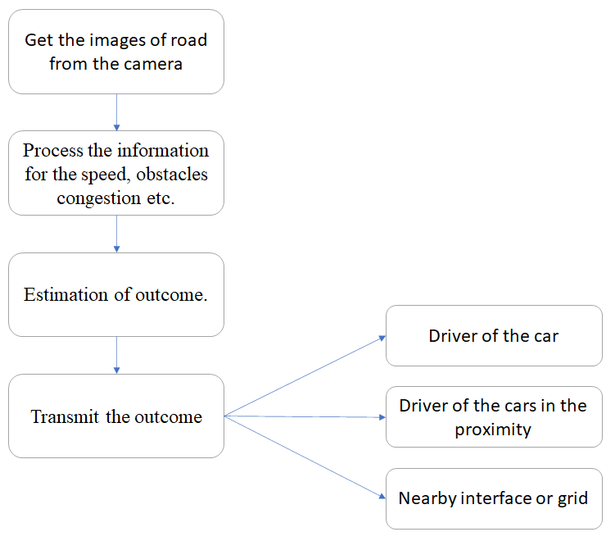
Go, change the world
RV College of
Engineering
Basic Idea of the Project Methodology
The basic idea of the project is to indicate the driver and drivers in the proximity of the transmitting car(transmitter) about the probability of accidents, obstacles or congestion on the road hence preventing the mishaps.
Depending on the received data by the driver and drivers in the proximity of the transmitting vehicle, the action can be taken.
Fig.3 – Basic idea

Slide 19
Go, change the world
RV College of
Engineering
Hardware and software components required
Hardware Components
Software Components
Camera
Li-Fi module
Arduino Uno/NANO
Connecting wires
Vehicles for testing
PYTHON(Simulation).
ARDUINO IDE
PyIDLE
PySerial

Slide 20
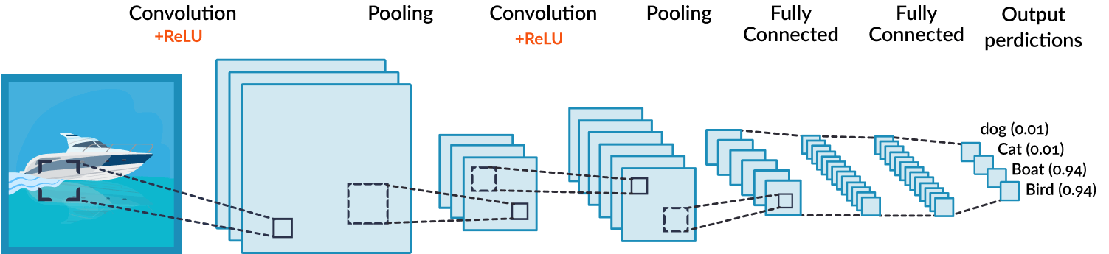
Go, change the world
Convolutional Neural Network
RV College of
Engineering
A Convolutional Neural Network (ConvNet/CNN) is a Deep Learning algorithm which can take in an input image, assign importance to various aspects/objects in the image and be able to differentiate one from the other.
The pre-processing required in a ConvNet is much lower as compared to other classification algorithms.
With enough training, ConvNets have the ability to learn these filters/characteristics.
The architecture performs a better fitting to the image dataset.
The role of the ConvNet is to reduce the images into a form which is easier to process, without losing features which are critical for getting a good prediction.
Fig.4 Blocks In a Convolutional Neural Network

Slide 21

Go, change the world
RV College of
Engineering
Convolutional Neural Network
FILTERING & NORMALIZATION: CONVOLUTION + RELU
FILTERING:
Line up a feature and the image patch.
Multiply each image pixel by the corresponding feature pixel.
Add them up.
Divide by the total number of pixels in a image.
NORMALIZATION:
Change the negative values to 0.
Fig.5 Filtering in CNN
Kernel/Filter,
K = 1 0 1 0 1 0 1 0 1
Fig 6 Filter Used

Slide 22


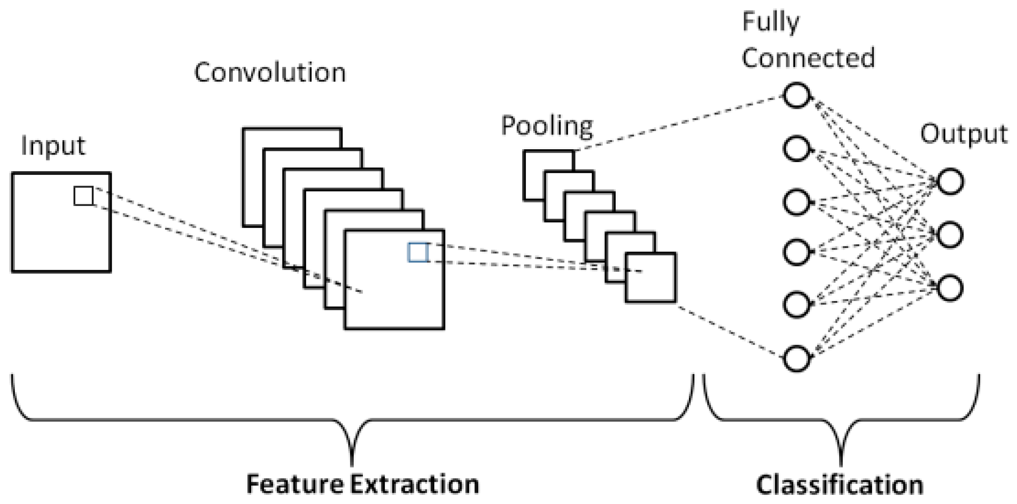

Go, change the world
RV College of
Engineering
Convolutional Neural Network
POOLING: RESIZING
Shrinking the image stack.
Pick a window size.
Pick a stride.
Walk the window across the filtered image.
From each window, take the maximum value.
FULLY CONNECTED LAYER
Every value gets a vote.
A list of feature values becomes list of votes.
Errors are adjusted based on gradient descent approach.
Fig.7 Filter windowing
Fig.8 Basic Convolution
Fig.9 Structure of CNN
Fig.10 Gradient Descent

Slide 23
Go, change the world
Haar Cascade Classifier
RV College of
Engineering
Haar-Cascading algorithm is a Machine Learning Classification algorithm.
In this algorithm, the cascade function is trained using many positive and negative samples.
The Haar Cascade Classifier is trained in four stages.
Haar Feature Selection: This feature detects and considers the adjacent rectangular regions in the given image segment, and it adds to the pixel intensities in each image and calculates the difference between the two sums.
Integral Images: Integral Images boost the speed of the classifier. It makes the computations super-fast.
Boosting Algorithm: This algorithm is used to select best features out of many features and to train the classifiers depending on the performance. We mainly use Adaboost algorithm at this stage.
Cascade Classifier: These classifiers are collections of many stages. Each stage represents a weak classifier commonly referred to as decision stumps. These decision stumps are trained by using Boosting Technique, which has the ability to train a highly accurate classifier which uses a weighted average of the decision made by the decision stumps.
23

Slide 24
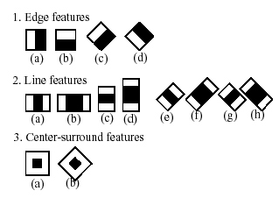
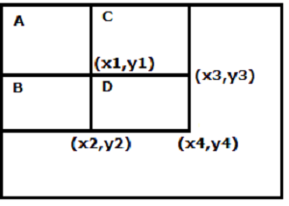
Go, change the world
RV College of
Engineering
WORKING OF THE CLASSIFIER
1. Feature Selection
F(haar)=F(white)-F(black)
Where, ∑f(white) is the number of pixels in white region, ∑f(black) is the number of pixels in black, F(haar) is haar feature.
Fig.11 Features
2. Integral Images
Sum=(D+A)-(B+C)
Sum=(x4,y4)+(x1,y1)-((x3,y3)+(x2,y2))
Fig.12 Integral Image Formation
24

Slide 25
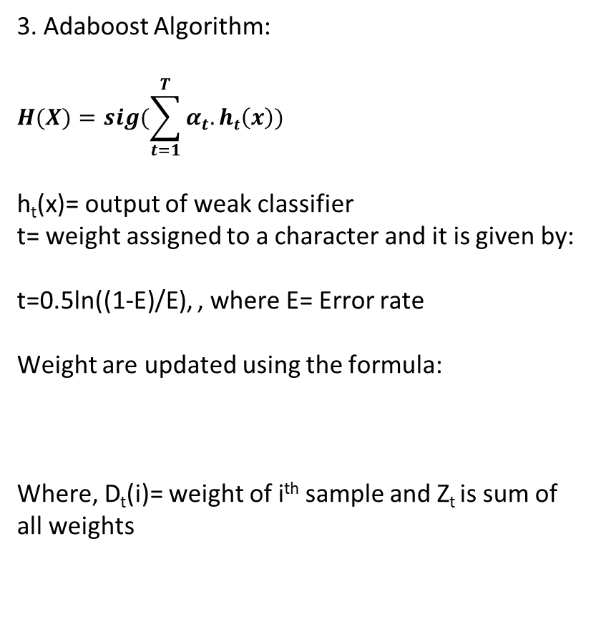
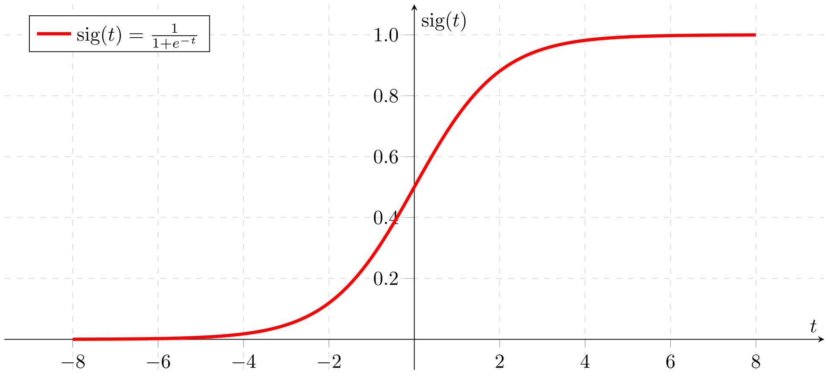
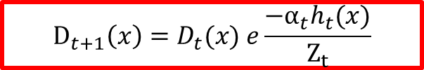
Go, change the world
RV College of
Engineering
WORKING OF THE CLASSIFIER
Fig.13 Sigmoid Function
4. Cascade Classifier
The stages of the classifier are given by current locations of the sliding window.
The stages may be positive or negative. When an object is detected, the region is considered to be positive and when there is no object detected, the region is considered to be negative.
When the final region is detected as positive, the detector reports the object as found. There are some cases where a classifier might give an error with respect to classification.
Condition | Outcome
Positive | Object detected and recognised
Negative | Object not detected and not recognised
False Positive | Object not detected but recognised
False Negative | Object detected but not recognised
25

Slide 26
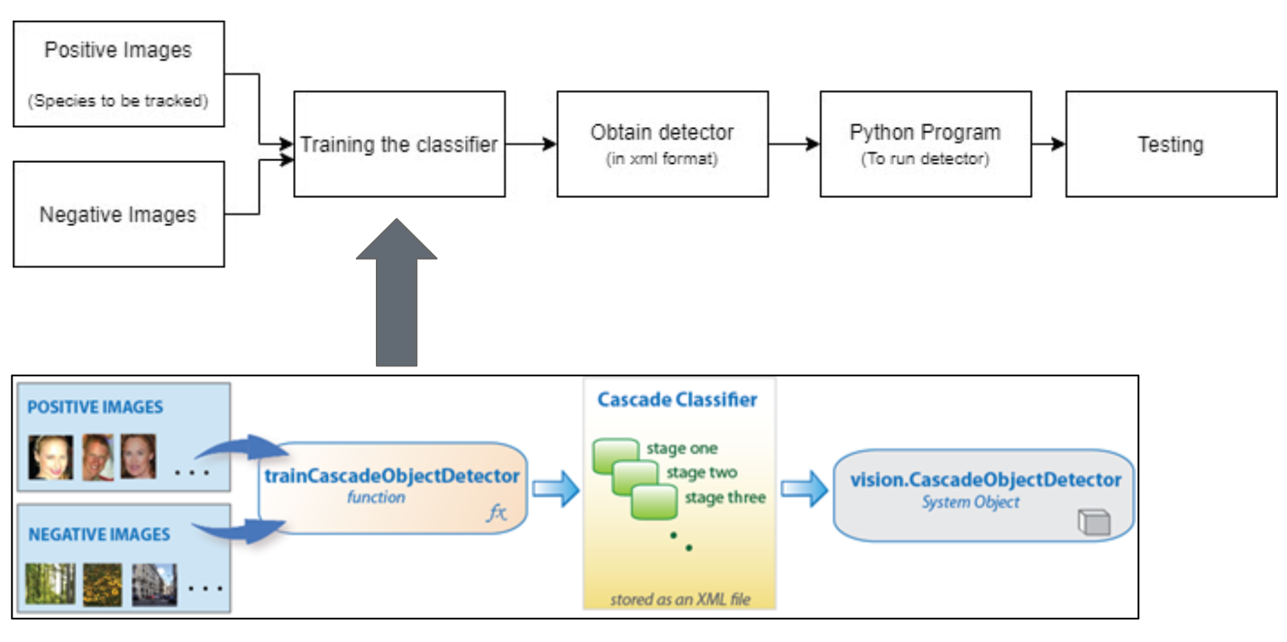
Go, change the world
RV College of
Engineering
CASCADE CLASSIFIER SUMMED UP
Fig.14 Cascade Classifier Summed-up
26

Slide 27
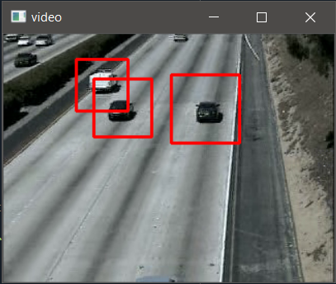
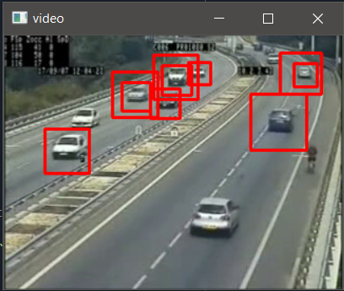
Go, change the world
RV College of
Engineering
Obtained Output Of The Detector using CNN
Fig.15 One way detection using CNN
Fig.16 two way detection using CNN

Slide 28
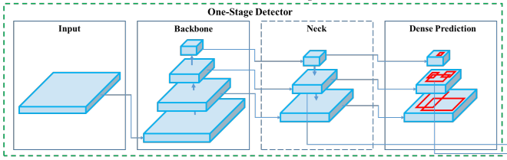
Go, change the world
RV College of
Engineering
YOLO Algorithm
You Only Look Once
It is a pretrained algorithm for image recognition
It has One Stage Detectors
The layers of one stage detectors include-
Backbone layer
Neck
Head/ dense prediction
Fig.17 Basic Architecture of One Stage Detectors

Slide 29
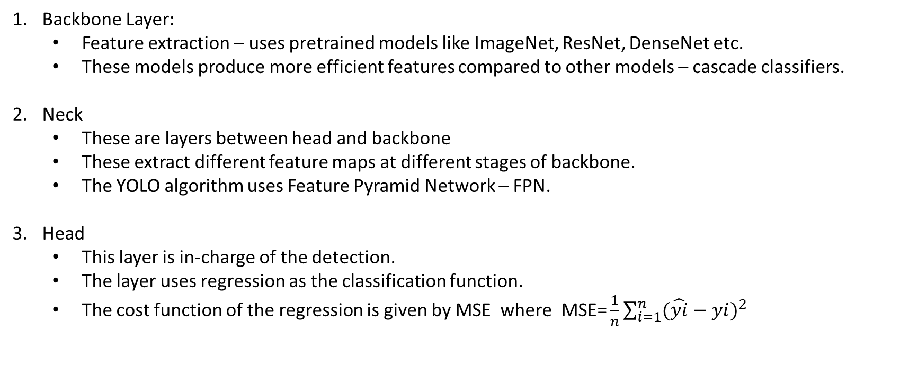
Go, change the world
RV College of
Engineering
YOLO Algorithm
Backbone Layer:
Feature extraction – uses pretrained models like ImageNet, ResNet, DenseNet etc.
These models produce more efficient features compared to other models – cascade classifiers.
Neck
These are layers between head and backbone
These extract different feature maps at different stages of backbone.
The YOLO algorithm uses Feature Pyramid Network – FPN.
Head
This layer is in-charge of the detection.
The layer uses regression as the classification function.
The cost function of the regression is given by MSE where$\text{MSE}\text{=}\frac{1}{n}\sum_{i=1}^{n}{{(\hat{yi}−yi)}^{2}}$

Slide 30
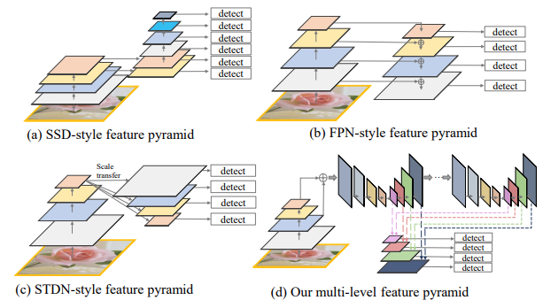
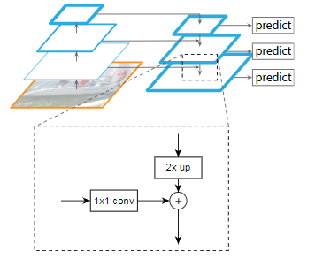
Go, change the world
RV College of
Engineering
Feature Pyramid Network – FPN.
Fig.18 FPN basics
Fig.19 Different types of FPN

Slide 31
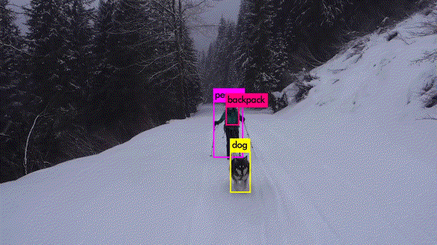
Go, change the world
RV College of
Engineering
YOLO V4 Algorithm
Version used is 4th version
Classes used COCO.names for recognition
Coco.names is a set of 80 classes
Fig.20 YOLO Algorithm Example

Slide 32
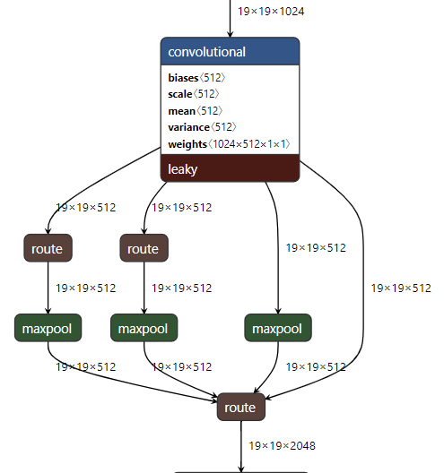
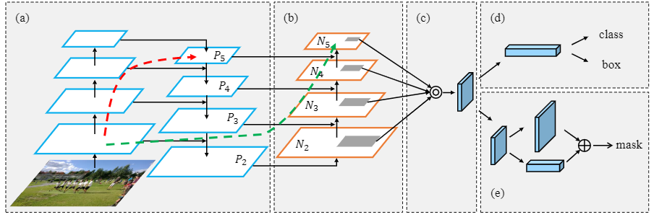
Go, change the world
RV College of
Engineering
YOLO V4 Algorithm
Backbone:
CSP DarkNet as feature extractor model for GPU (Graphical Processing Unit).
EfficientNet Lite-MixNet-GhostNet/MobileNet for VPU (Visual Processing Unit).
Neck:
Uses Spatial Pyramid Pooling (SPP) and Path Aggression Network (PAN)
Fig 21. PAN of YOLO V4
Fig 22 SPP of YOLO V4

Slide 33
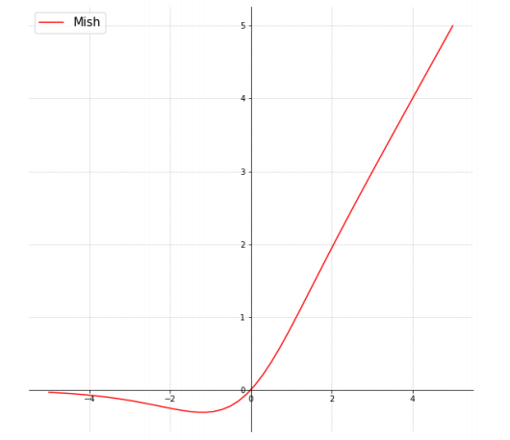
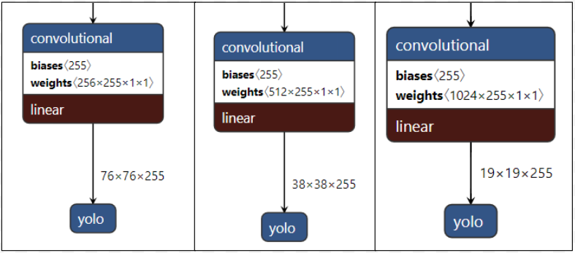
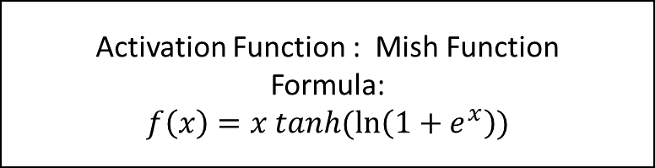
Go, change the world
RV College of
Engineering
YOLO V4 Algorithm
Head :
The layer is applied at different scales of the network.
Detects objects of different scales/sizes.
Number of channels is 255
Activation Function : Mish Function
Formula:
$$f\left(x\right)=x tanh(\ln\left(1+e^{x}\right))$$
Fig.23 YOLO V4 head layer
Fig. 24 Mish Graph

Slide 34
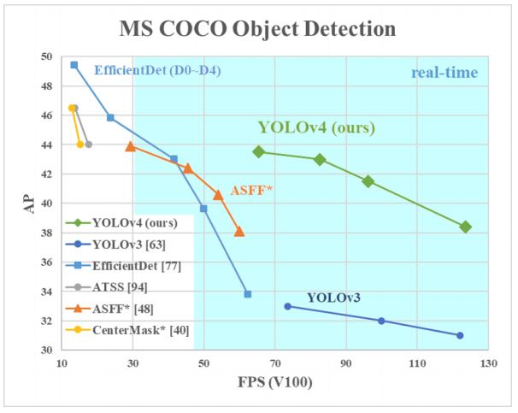
Go, change the world
RV College of
Engineering
Why YOLO Algorithm?
Simple
Effective
Not much false positives
V4 of YOLO Algorithm yields better results in real time environment.
Figure 25 represents the comparison of YOLO Versions 3 and 4 on COCO classes
Fig.25 YOLO V3 vs YOLO V4

Slide 35
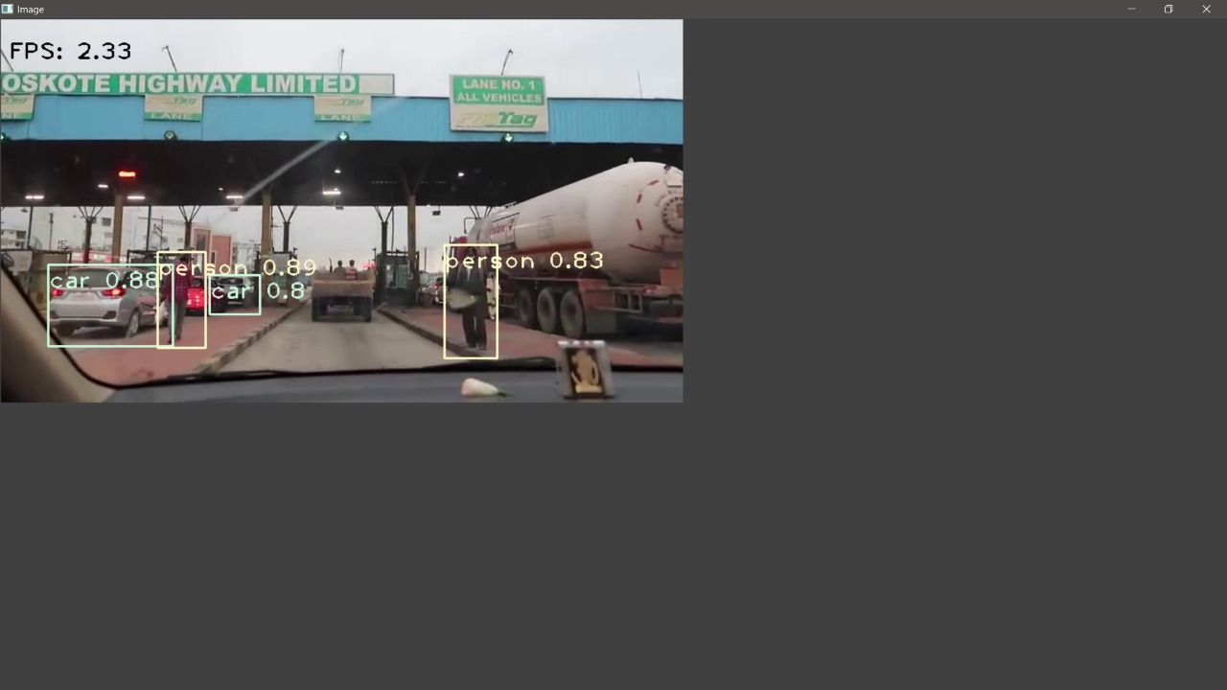
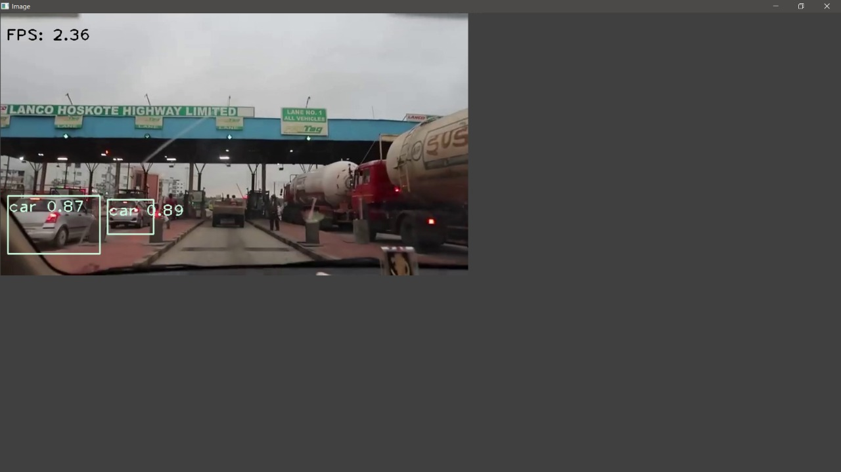
Go, change the world
RV College of
Engineering
Outputs Obtained while using YOLO Algorithm on Data Set 1
Fig.26a Detection on Data Set 1
Fig.26b Detection on Data Set 1
The Accuracy the algorithm is found to be 85% in the Figure 26a approximately
The accuracy is found to be 88% in the figure 26b approximately

Slide 36
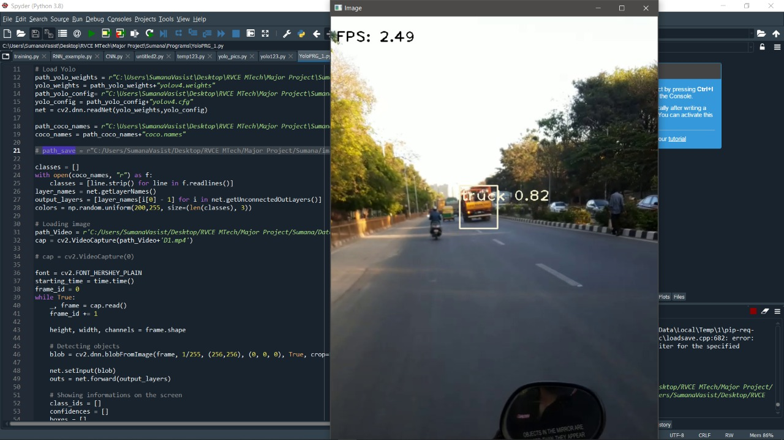
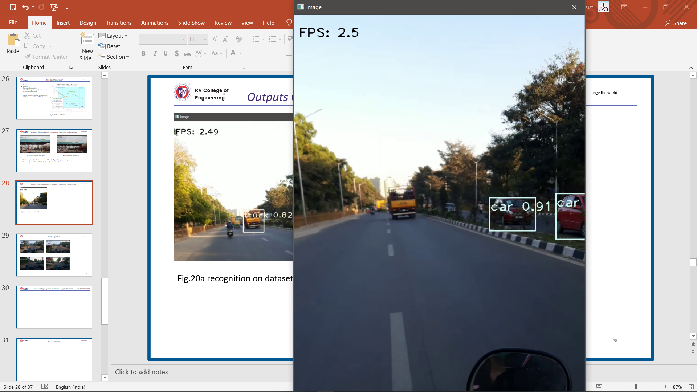
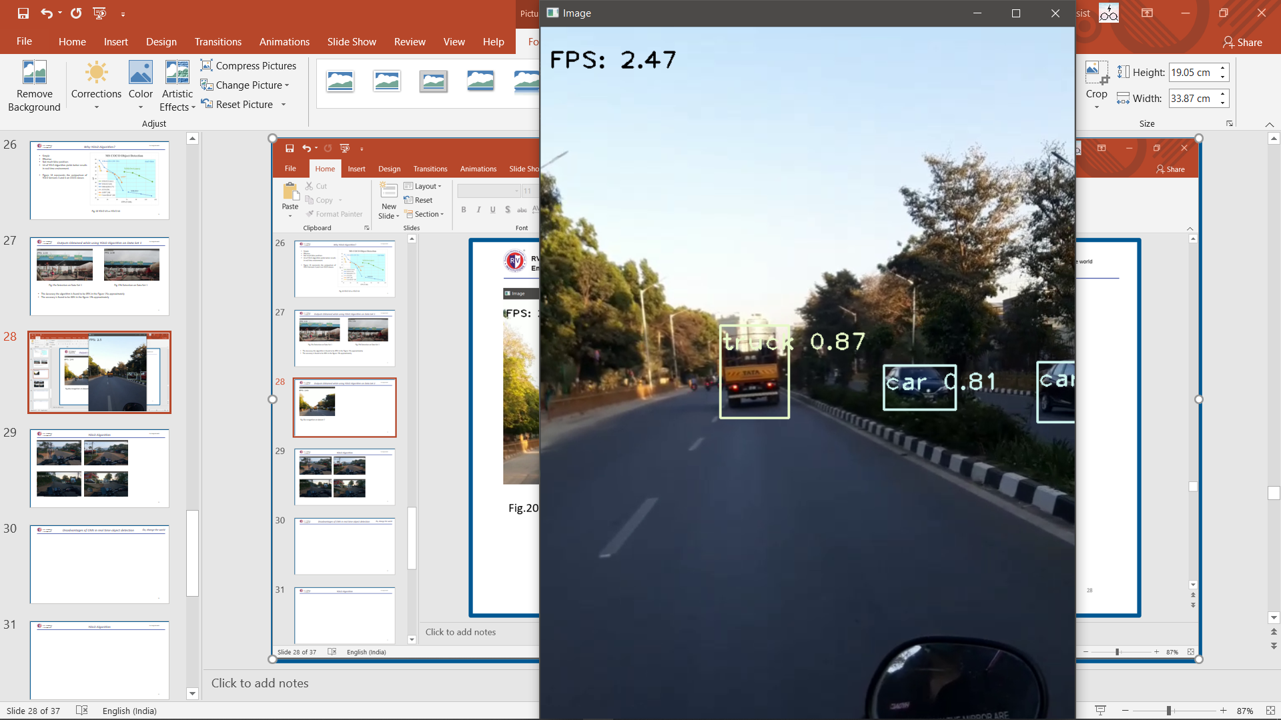
Go, change the world
RV College of
Engineering
Outputs Obtained while using YOLO Algorithm on Data Set 2
Fig.27a recognition on dataset 2
Fig.27b recognition on dataset 2
Fig.27c recognition on dataset 2
Accuracy is found >80% and in some cases >90% for Recognition in data set 2

Slide 37
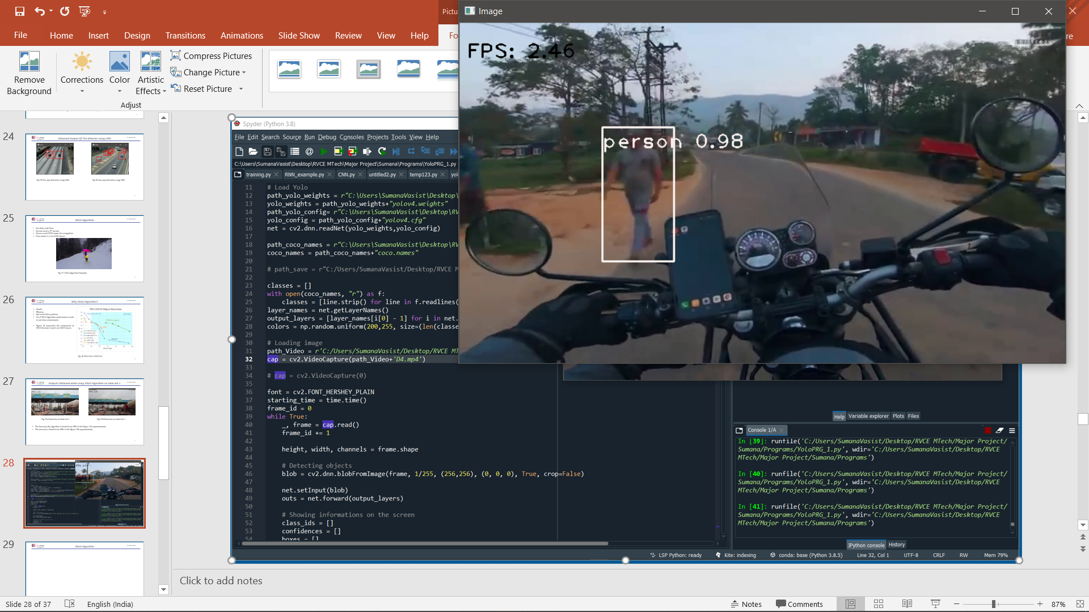
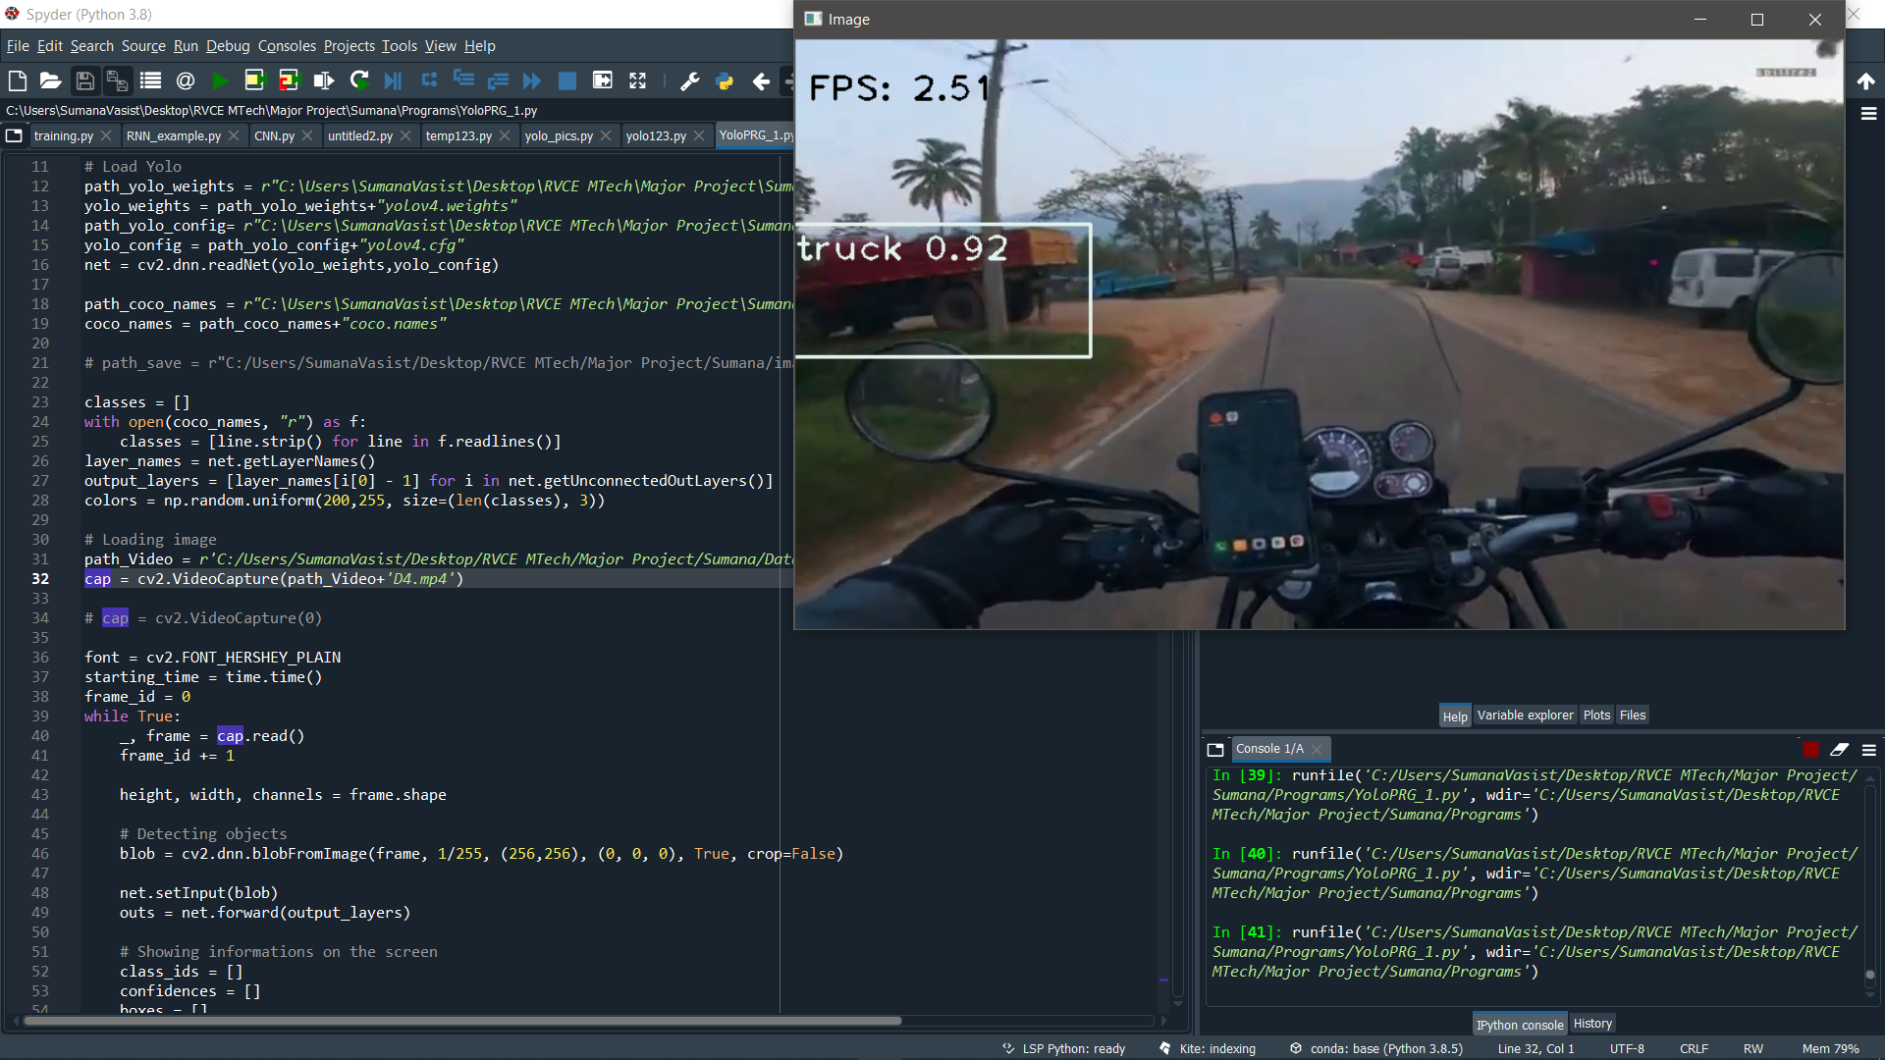
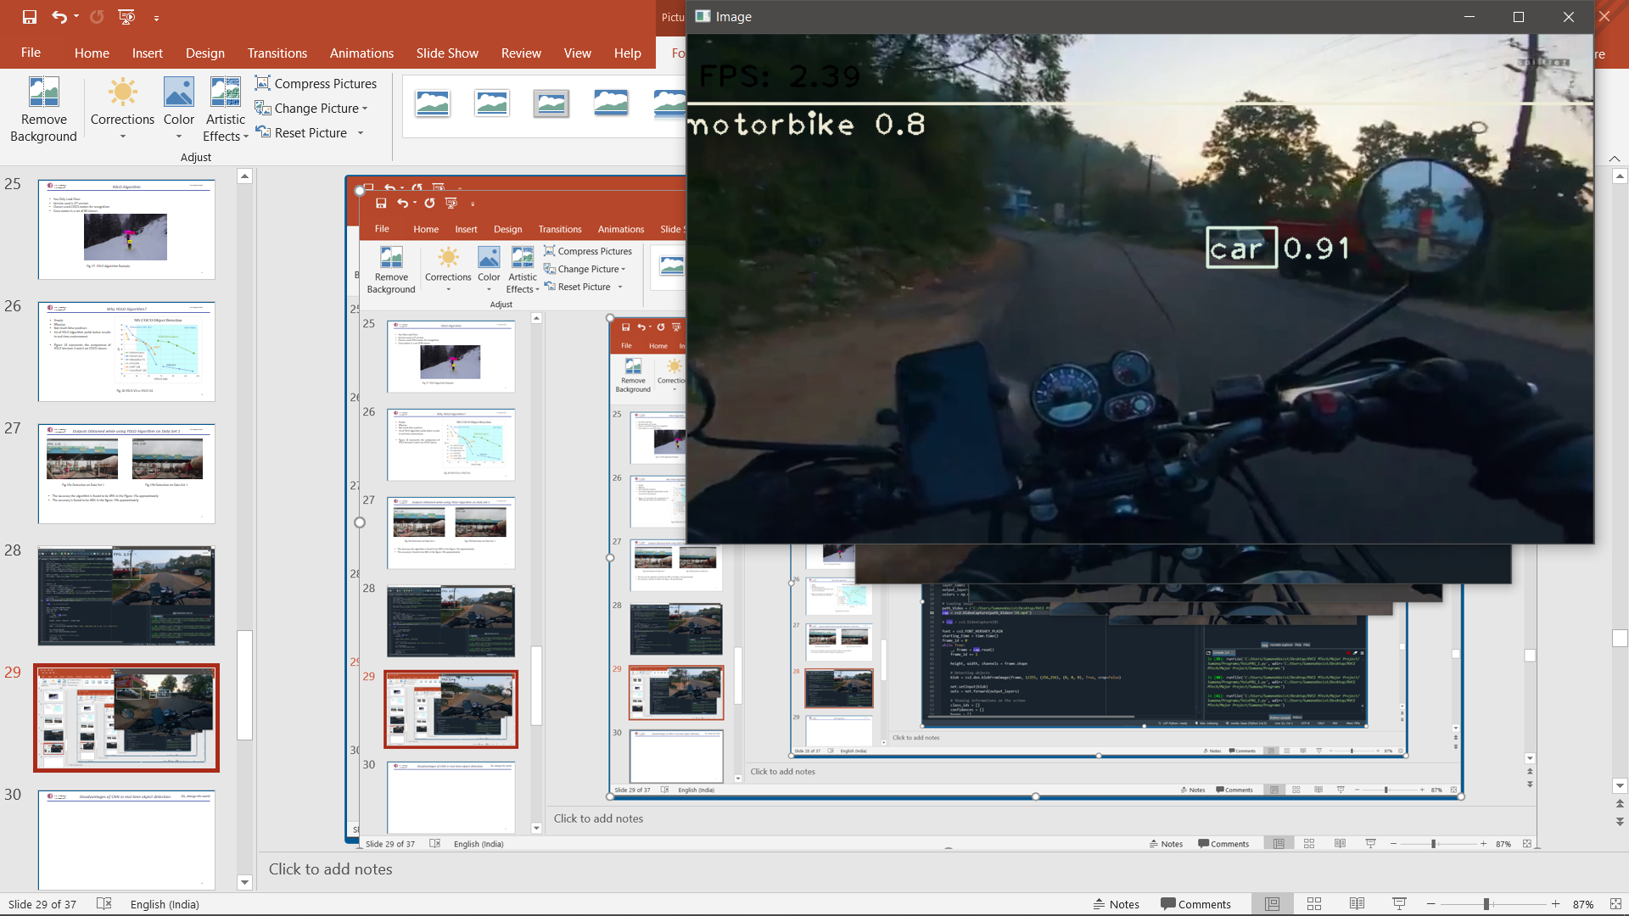
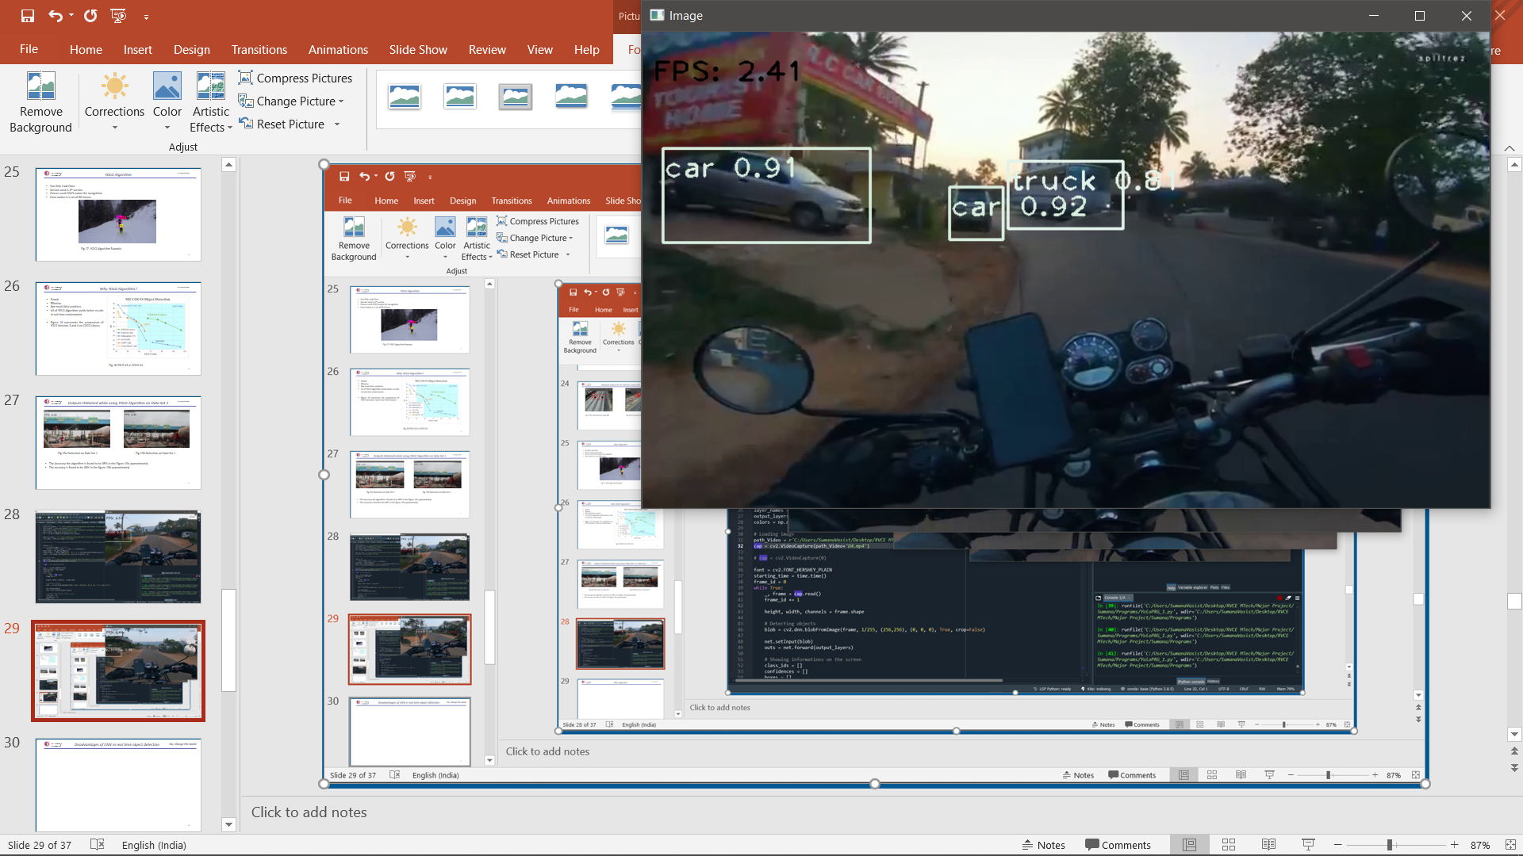
Go, change the world
RV College of
Engineering
Outputs Obtained while using YOLO Algorithm on Data Set 2
Accuracy is found >80% and in some cases >90% for Recognition in data set 2
Fig.28a Recognition is Data set 3
Fig.28b Recognition is Data set 3
Fig.28c Recognition is Data set 3
Fig.28d Recognition is Data set 3

Slide 38
Go, change the world
RV College of
Engineering
Challenges faced while Recognition
Algorithm does not work at night time.
Possible reasons include
Less background light making it impossible for feature extraction.
Interference due to high beam from the vehicles in the opposite lane.
The algorithm fails at higher FPS i.e., FPS > 3
Possible reasons:
The exact or approximate Non-Maximal Suppression ratio at higher FPS is difficult to determine

Slide 39
Go, change the world
RV College of
Engineering
Objectives completed and to be completed
Objectives Completed:
To detect various on-road obstacles such as vehicles, speed brakes, traffic signals, animals etc.
To process the obtained data and classify to respective classes (animals, cars, etc).
Collect Real-time Data of the On-road objects.
Objectives to be completed:
To develop a prototype of Vehicular Communication System (Tx and Rx) using VLC.
Hardware Design is completed, fabrication is in progress.
Performance evaluation of the complete system with respect to delay, throughput, packets loss indicator.

Slide 40
Go, change the world
RV College of
Engineering
Hardware Design
The Hardware of the prototype is designed using Eagle Cad 2019 version.
The hardware mainly consists of the following elements:
Arduino Nano – Acts as controller and also for modulation and encoding.
LCD display – used as an indicator to display the messages.
LEDs – for transmission of data.
LDR for reception of data.
Resistors.
Connecting wires.
The designed transmitter and receiver is also converted into Vboard diagrams for fabrication.

Slide 41
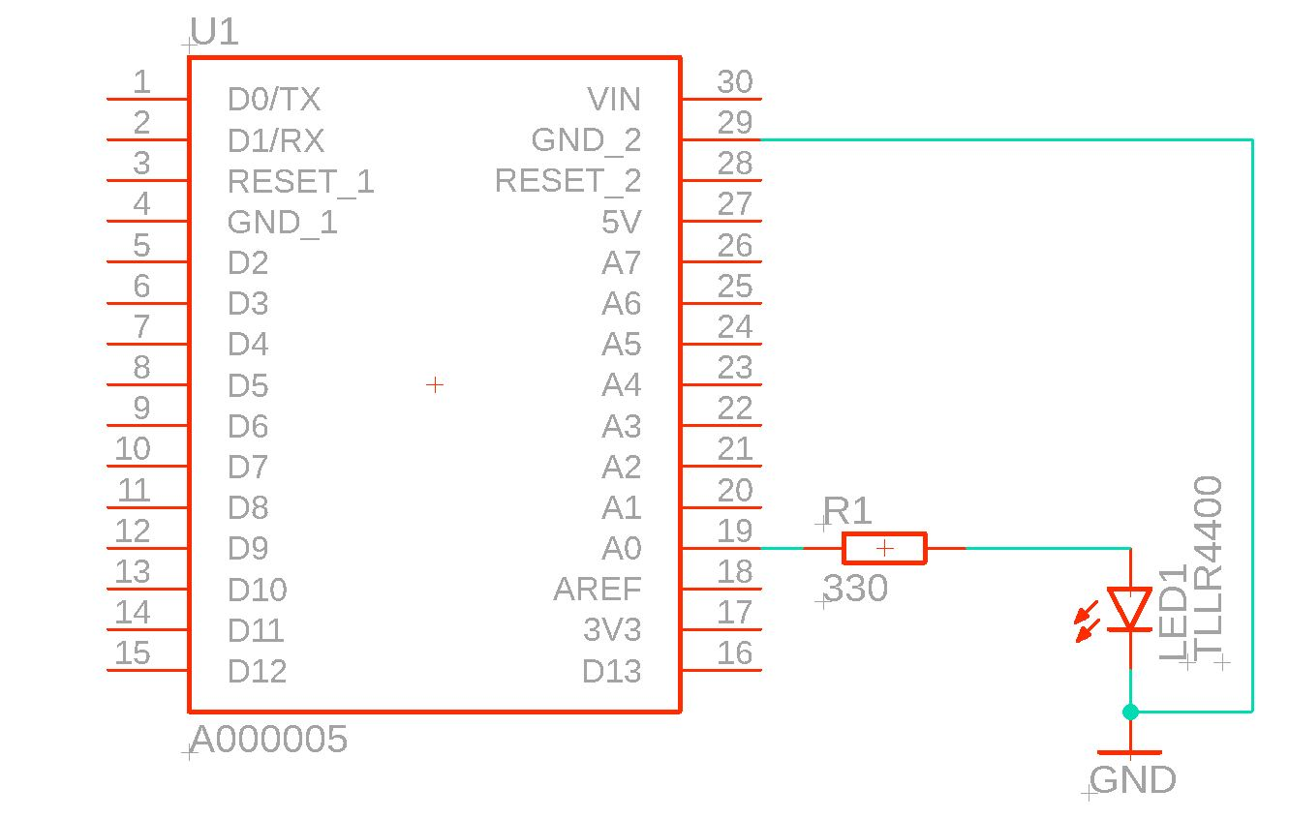
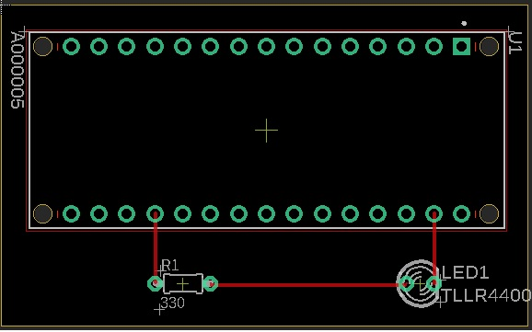
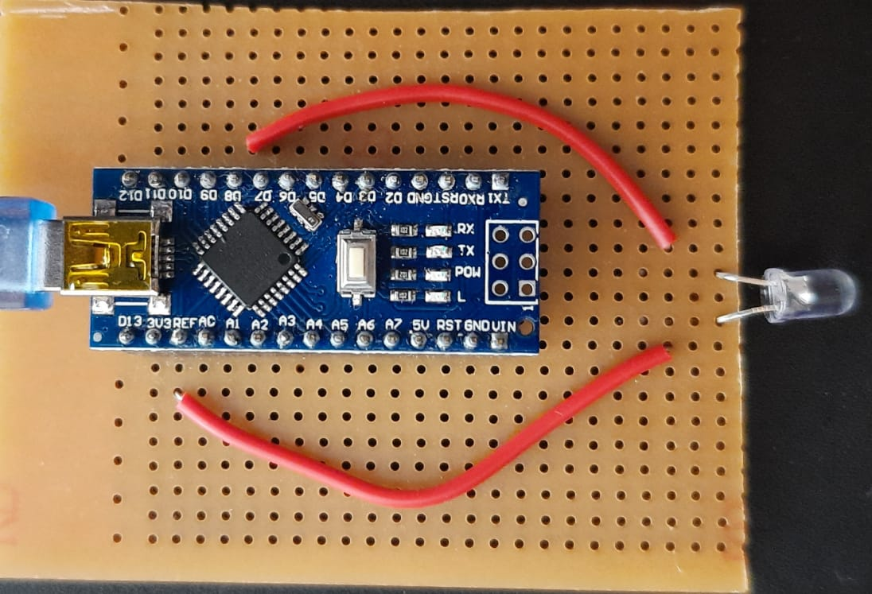
Go, change the world
RV College of
Engineering
Hardware Design of Transmitter
The figures – 29a,29b and 29c represent the circuit diagram , board diagram and implementation of the Transmitter.
Fig.29a Circuit Diagram if transmitter
Fig.29b Board Diagram of transmitter
Fig.29c Implementation of transmitter

Slide 42
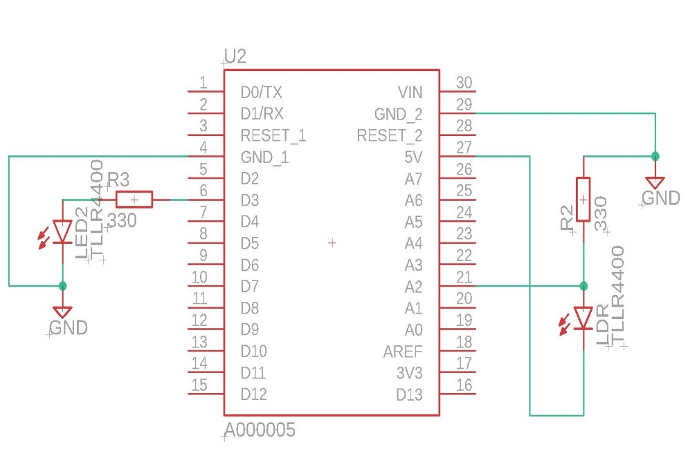
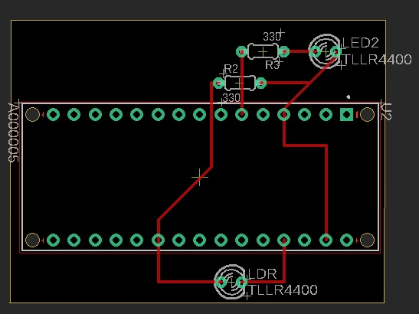
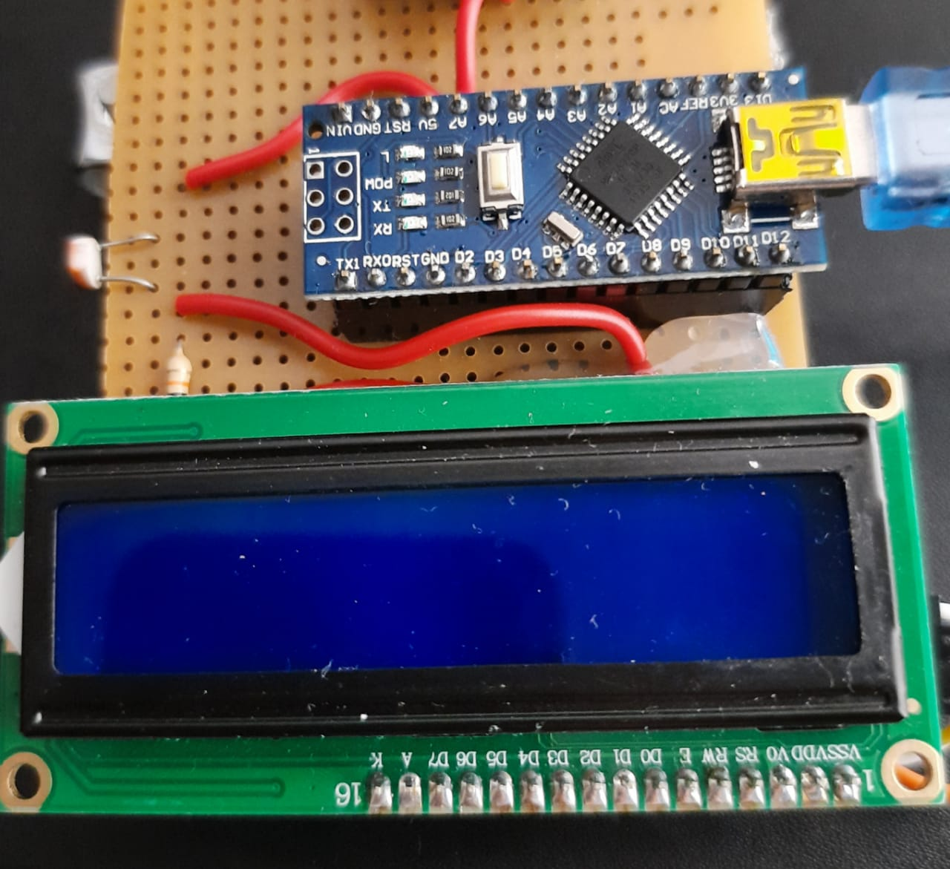
Go, change the world
RV College of
Engineering
Hardware Design of Receiver
The figures – 30a, 30b and 30c represent the circuit diagram , board diagram and implementation of the Receiver.
Fig.29a Circuit Diagram of receiver
Fig.29b Board Diagram of receiver
Fig.29c Implementation of receiver

Slide 43
Go, change the world
RV College of
Engineering
Pseudocode of Final Algorithm
Final Algorithm of the Detection using YOLO V4 is as shown in Pseudocode 1.
Pseudocode 1: detection algorithm:
Get live video feed from the camera.
Convert the video to different frames.
Determine the requires FPS for the detection.
Perform pre-processing and feature extraction.
Create YOLO V4 network using configuration required
Create Classes using Class names and wights in the COCO.names dataset.
Input the outputs of 4 and 5 to the YOLO V4 network.
Check for matching weights and features.
If a match is found:
get the index
perform non-maximal suppression to eliminate false positives,
label with class names and confidences
finally write onto serial port for transmission.
If match is not found, repeat from step 7.
Repeat from step 7 till specified time till character key ESC is pressed.
Send the detected obstacle to serial port for transmission.

Slide 44
Go, change the world
RV College of
Engineering
Pseudocode of Final Algorithm
Pseudocodes 2 and 3 represent the transmission and reception of data at transmitter and receiver respectively.
Pseudocode 2: Transmission of data
Get obstacle name as serial input to transmitter.
Compare with the obstacle variable.
Set delay accordingly for the ON-state of the LED.
Car = 50ns
Person = 70ns
Motorbike = 100ns
Truck = 120ns
Bus = 150ns
Turn the LED OFF.
Pseudocode 3: Reception of data
Measure the amount of time for which the photosensor senses the light.
Map the time to respective obstacle.
LED ON = 50ns => Car
LED ON = 70ns => Person
LED ON = 100ns =>Motorbike
LED ON = 120ns =>Truck
LED ON = 150ns =>Bus
Display on the display device as an indication.

Slide 45
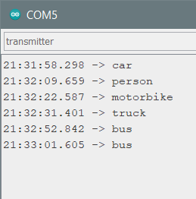
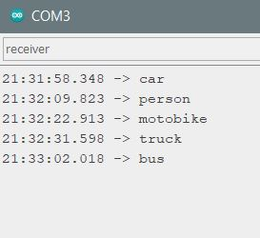
Go, change the world
RV College of
Engineering
Outputs Of hardware at Arduino
Figures 30 and 31 represent the output at the communication port of Arduino Nano of Transmitter and receiver respectively.
Fig.30 COM output at Transmitter
Fig.31 COM output at Receiver

Slide 46
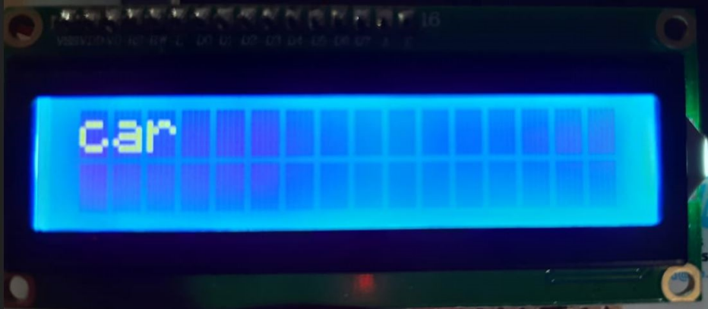
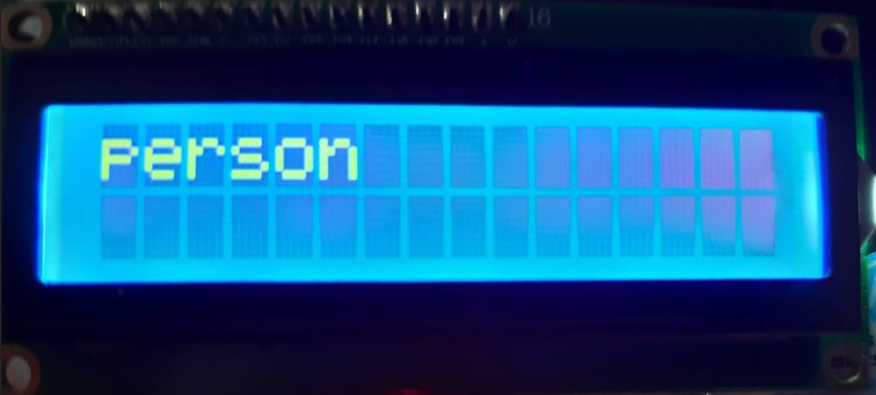
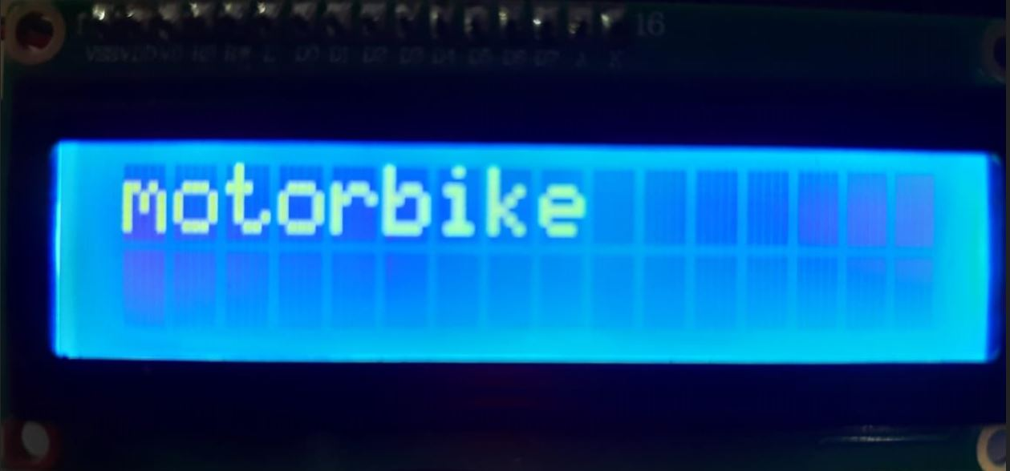
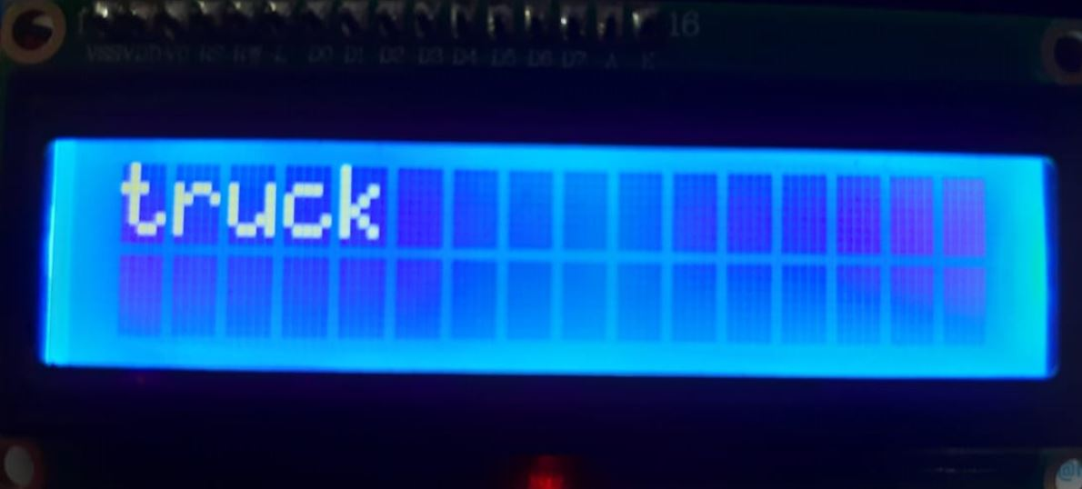
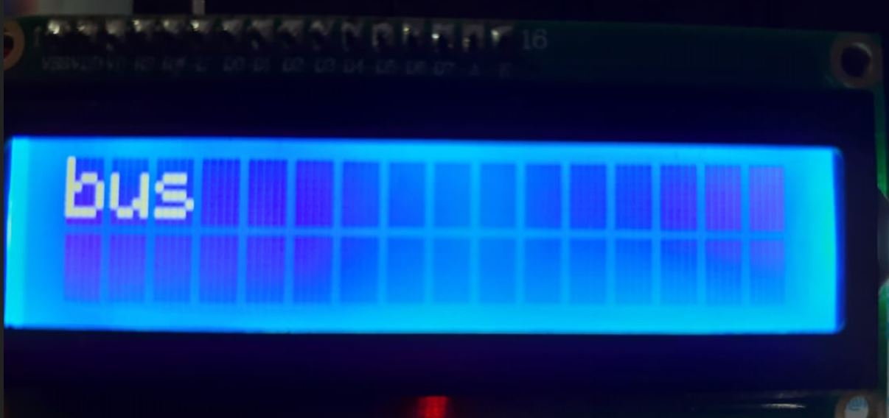
Go, change the world
RV College of
Engineering
Outputs Of hardware at Receiver
Figures 32 - 36 represents the output obtained on the LCD Display after transmission.
Fig.32 LCD when “car” is transmitted
Fig.33 LCD when “person” is transmitted
Fig.34 LCD when “motorbike” is transmitted
Fig.35 LCD when “truck” is transmitted
Fig.36 LCD when “car” is transmitted

Slide 47
Go, change the world
RV College of
Engineering
Observations
CNN Algorithm
CNN algorithm using Cascade Classifier when executed for the object detection showed a lot of false positives.
Hence in order to reduce the number of false positives, a lot of changes needed to be and the efficiency of the algorithm was found to be very less.
The algorithm was not able to detect objects in dim lighting because the feature extraction would be a problem.
In order to overcome these drawbacks, YOLO algorithm was used.
YOLO V4 Algorithm
When using YOLO Algorithm, a set of certain system specifications are to be met.
In the systems where these specifications are not met, it is not feasible to execute this algorithm as it may crash the system.
Though the algorithm can detect the obstacles in dim lights, it cannot detect the obstacles in the dark.
This may be due to the no background light which makes it impossible for feature extraction and also interference due to high beam lights which blind the camera because of very high intensity light.
The algorithm also fails at higher FPS for more accurate detection of objects.
This is due to the fact that it is very difficult to determine the Non-Maximal Suppression ratio at higher FPS.

Slide 48
Go, change the world
RV College of
Engineering
Observations
Vehicle to vehicle communication system
It is observed that the proposed V2V System is highly directional. i.e., the photo sensor is to be aligned with the LED in a single line.
The reception is not possible if they are not in the same line.
The automation of the serial writing of the transmitted string is difficult as the python is not compatible with Arduino but by using some libraries it can be achieved.
The range of the proposed system is very short and it can be extended by using mirroring techniques as well as high power LED to transmit data.
Since the transmission and reception is highly directional, laser can also be used in place of LED. This will yield in higher accuracy and less latency when compared to LED.

Slide 49
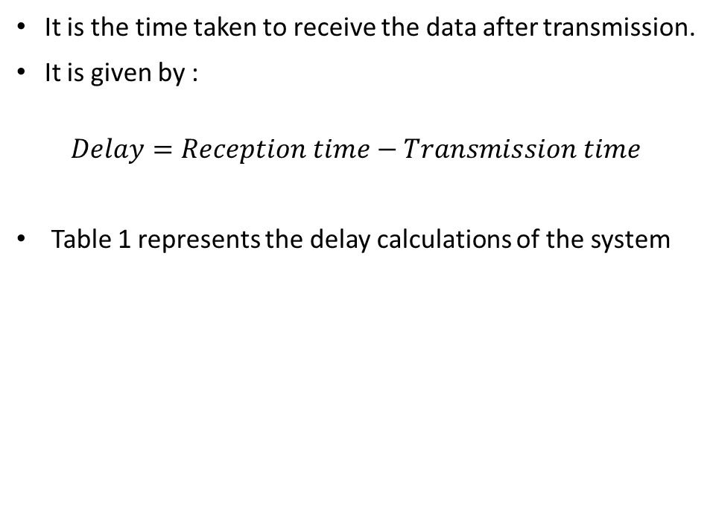
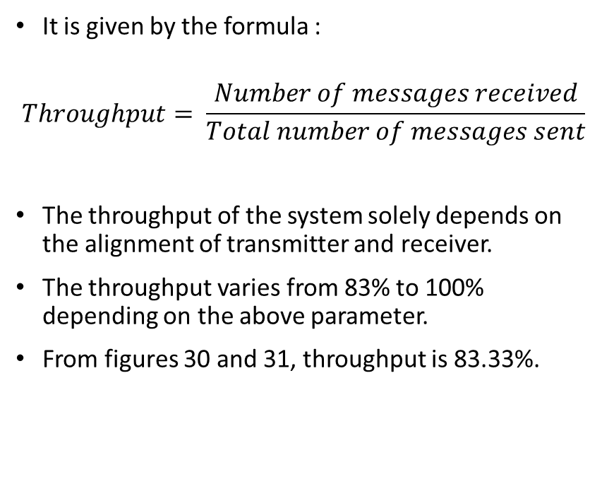
Go, change the world
RV College of
Engineering
Calculation of Throughput and Delay
Throughput
Delay
It is given by the formula :
$$Throughput= \frac{Number of messages received}{Total number of messages sent}$$
The throughput of the system solely depends on the alignment of transmitter and receiver.
The throughput varies from 83% to 100% depending on the above parameter.
From figures 30 and 31, throughput is 83.33%.
It is the time taken to receive the data after transmission.
It is given by :
$$Delay=Reception time−Transmission time$$
Table 1 represents the delay calculations of the system
Transmission time (HH:MM: SS.ms) | Reception Time (HH:MM: SS.ms) | Delay (ms)
21:31:58.298 | 21:31:58.348 | 0.05
21:32:09.659 | 21:32:09.823 | 0.164
21:32:22.587 | 21:32:22.913 | 0.326
21:32:37.401 | 21:32:31.598 | 0.197
21:33:01.605 | 21:33:02.018 | 0.413

Slide 50
Go, change the world
RV College of
Engineering
Conclusion
The usage of VLC system for vehicular communication has major advantages and can be most effective when compared to present RF technology systems. It can be concluded that the VLC uses unlicensed band for communication. The bandwidth provided is greater when compared to existing RF technologies.
The other advantages include –
There is no electro-magnetic interference.
There is less power consumption
More secure due to LOS communication.
Less or no risk because of lesser consumption of transmission power.
Installation complexity is very less.
Power amplifier is not required.
DSRC for better communication with less outdoor noise considerations.

Slide 51
Go, change the world
RV College of
Engineering
Future Scope
The Various aspects which can be further explored in the research are as follows.
The detection algorithm for object detection in darker environment can be developed.
The omni-directional receivers can be researched.
The use of lights of different frequencies and wavelengths for the transmission and reception and their performance analysis can be made.
The transmitter and receiver placement on the vehicle for better performance can be studied.
Another detailed study for the location of camera can be made with respect to different vehicles in picture.
The issue of range and its extension by techniques can be researched.

Slide 52
Go, change the world
RV College of
Engineering
References
[1] Zorkany, M. & Galal, Ahmed. “Vehicle To Vehicle “V2V” Communication: Scope, Importance, Challenges, Research Directions and Future”, in proceedings of The Open Transportation Journal. 14. 86-98. 2020.
[2] S. Kulkarni, A. Darekar and S. Shirol, "Proposed framework for V2V communication using Li-Fi technology", in proceedings of International Conference on Circuits, Controls, and Communications (CCUBE), pp. 187-190, 2017.
[3] A. Aldalbahi, M. Rahaim, A. Khreishah, M. Ayyash and T. D. C. Little, "Visible Light Communication Module: An Open-Source Extension to the ns3 Network Simulator with Real System Validation", in IEEE Access, vol. 5, pp. 22144-22158, 2017.
[4] J. Choi et al., "Environment-Detection-and-Mapping Algorithm for Autonomous Driving in Rural or Off-Road Environment", in IEEE Transactions on Intelligent Transportation Systems, pp. 974-982, 2012.
[5] S. J. Lee, J. K. Kwon, S. Y. Jung and Y. H. Kwon, "Simulation modelling of visible light communication channel for automotive applications", in 15th International IEEE Conference on Intelligent Transportation Systems, pp. 463-468, 2012.
[6] C. Huang, M. Chiang, D. Dao, W. Su, S. Xu and H. Zhou, "V2V Data Offloading for Cellular Network Based on the Software Defined Network (SDN) Inside Mobile Edge Computing (MEC) Architecture", in IEEE Access, vol. 6, pp. 17741-17755, 2018.
[7] K. Siddiqi, A. D. Raza and S. S. Muhammad, "Visible light communication for V2V intelligent transport system", in International Conference on Broadband Communications for Next Generation Networks and Multimedia Applications (CoBCom), pp. 1-4, 2016.
[8] M. Kowalczyk and J. Siuzdak, "VLC link with LEDs used as both transmitters and photo-detectors", in proceedings of Seventh International Conference on Ubiquitous and Future Networks, pp. 893-897, 2015.

Slide 53
Go, change the world
RV College of
Engineering
References
[9] S. Rajagopal, R. D. Roberts and S. Lim, "IEEE 802.15.7 visible light communication: modulation schemes and dimming support", in IEEE Communications Magazine, vol. 50, no. 3, pp. 72-82, 2012.
[10] T. L. Pham, M. Shahjalal, V. Bui and Y. M. Jang, "Deep Learning for Optical Vehicular Communication", in IEEE Access, vol. 8, pp. 102691-102708, 2020.
[11] T. Huynh, T. Pham and M. Yoo, "Detection Algorithm for Overlapping LEDs in Vehicular Visible Light Communication System", in IEEE Access, vol. 7, pp. 109945-109955, 2019.
[12] A. Demba and D. P. F. Möller, "Vehicle-to-Vehicle Communication Technology", in proceedings of IEEE International Conference on Electro/Information Technology (EIT), pp. 0459-0464, 2018.
[13]. Juxiang Chen et.al, “Face Recognition using depth image based convolutional neural network”, in the proceedings of International Conference on Computer, Information and Telecommunication Systems (CITS 2019), 978-1-7281-1374-6/19/, 2019.
[14] R. Zhang, F. Zhu, J. Liu and G. Liu, "Depth-Wise Separable Convolutions and Multi-Level Pooling for an Efficient Spatial CNN-Based Steganalysis", in IEEE Transactions on Information Forensics and Security, vol. 15, pp. 1138-1150, 2020.
[15] Y. Chen et al., "Drop an Octave: Reducing Spatial Redundancy in Convolutional Neural Networks with Octave Convolution," in proceedings of IEEE/CVF International Conference on Computer Vision (ICCV), pp. 3434-3443, 2019.
[16] M. B. Ullah, "CPU Based YOLO: A Real Time Object Detection Algorithm," in IEEE Region 10 Symposium (TENSYMP), pp. 552-555, 2020.

Slide 54
Go, change the world
RV College of
Engineering
References
[17] A. Sarda, S. Dixit and A. Bhan, "Object Detection for Autonomous Driving using YOLO [You Only Look Once] algorithm," in proceedings of Third International Conference on Intelligent Communication Technologies and Virtual Mobile Networks (ICICV), pp. 1370-1374, 2021.
[18] K. He, X. Zhang, S. Ren and J. Sun, "Spatial Pyramid Pooling in Deep Convolutional Networks for Visual Recognition," in IEEE Transactions on Pattern Analysis and Machine Intelligence, vol. 37, no. 9, pp. 1904-1916, 2015.
[19] K. O. Akande, P. A. Haigh and W. O. Popoola, "On the Implementation of Carrierless Amplitude and Phase Modulation in Visible Light Communication," in IEEE Access, vol. 6, pp. 60532-60546, 2018.
[20] C. S. priyadharshini, A. Rajeswari, P. Sharmila, M. Gayathri, K. Randhisha and M. C. Yazhini, "Design of Visible Light Communication System Using Ask Modulation," 2021 International Conference on Computing, Communication, and Intelligent Systems (ICCCIS), 2021, pp. 894-899.
[21] M. Raquibuzzaman, K. M. N. Akbar and M. M. Uddin, "Simple, low-cost micro-controller based data communication using ambient light sensor for VLC", International Conference on Control, Instrumentation, Communication and Computational Technologies (ICCICCT), pp. 121-125, 2016.
[22] Y. Yang and J. Luo, "Composite Amplitude-Shift Keying for Effective LED-Camera VLC," in IEEE Transactions on Mobile Computing, vol. 19, no. 3, pp. 528-539, 1 March 2020.
[23] M. Saadi, T. Sittivangkul, Yan Zhao, L. Wuttisittikulkij and P. Sangwongngam, "System demonstration for visible light communication using adaptive threshold detection for low data rate applications," in proceedings of IEEE International Conference on Electron Devices and Solid State Circuit (EDSSC), pp. 1-3, 2012.
[24] K. Gligorić, M. Ajmani, D. Vukobratović and S. Sinanović, "Visible Light Communications-Based Indoor Positioning via Compressed Sensing," in IEEE Communications Letters, vol. 22, no. 7, pp. 1410-1413, July 2018.

Slide 55
Go, change the world
RV College of
Engineering
References
[25] W. Thongsa, W. Wongtrairat and T. Sopon, "Design of Voltage Reference Comparator Circuit for Receiver Circuit in VLC System," in proceedings of 18th International Symposium on Communications and Information Technologies (ISCIT), 2018.s
[26] P. Araújo et al., "Performance Analysis of Two Machine-to-Machine Architecture Types in Vehicular Communications," in proceedings of IEEE 20th International Symposium on "A World of Wireless, Mobile and Multimedia Networks" (WoWMoM), pp. 1-9, 2019.
[27] K. Joshi, N. Roy, G. Singh, V. A. Bohara and A. Srivastava, "Experimental Observations on the Feasibility of VLC-Based V2X Communications under various Environmental Deterrents," IEEE International Conference on Advanced Networks and Telecommunications Systems (ANTS), pp. 1-4, 2019.
[28] T. L. Pham, M. Shahjalal, V. Bui and Y. M. Jang, "Deep Learning for Optical Vehicular Communication," in IEEE Access, vol. 8, pp. 102691-102708, 2020.
[29] A. Memedi and F. Dressler, "Vehicular Visible Light Communications: A Survey," in IEEE Communications Surveys & Tutorials, vol. 23, no. 1, pp. 161-181, 2021.
[30] M. Karbalayghareh, F. Miramirkhani, H. B. Eldeeb, R. C. Kizilirmak, S. M. Sait and M. Uysal, "Channel Modelling and Performance Limits of Vehicular Visible Light Communication Systems," in IEEE Transactions on Vehicular Technology, vol. 69, no. 7, pp. 6891-6901, July 2020.

